Slide 1
Robust Regression
Andy Wu

Slide 2
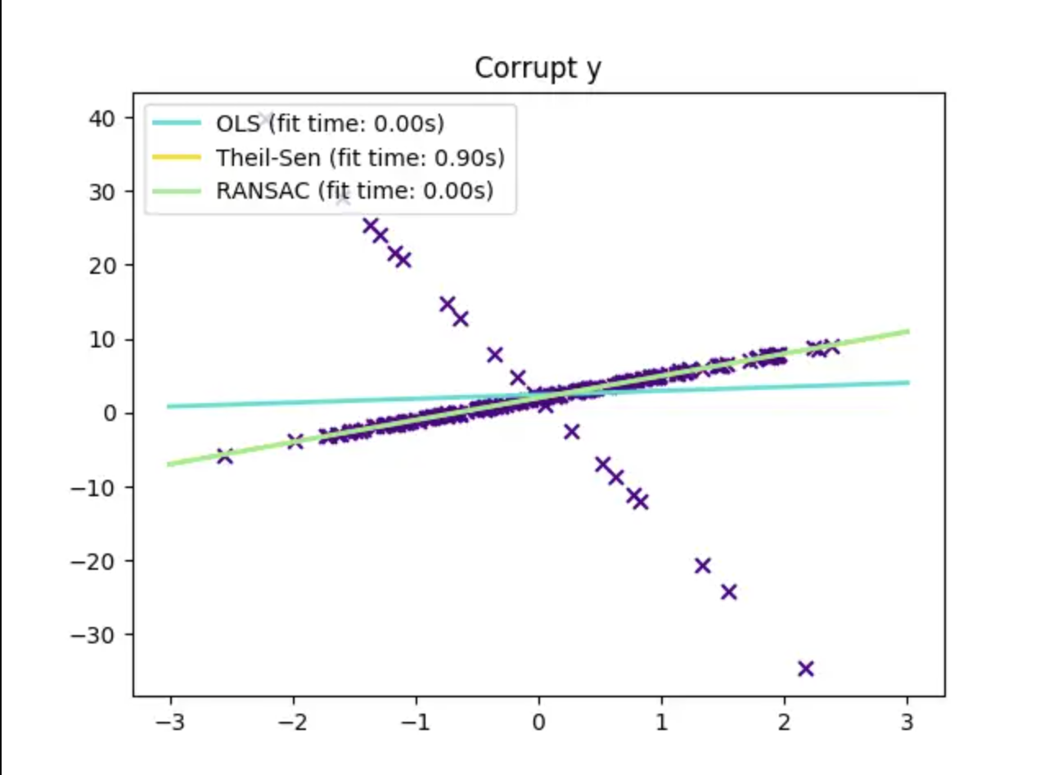
Advantages
When there’re lots of outliers...
As the diagram shows, while other models may be distracted by the huge amount of outliers, the model of robust regression deal with the outliers well and so there’s almost no influence from the outliers.
So Robust regression is used when there’re a number of outputs don’t meet our expectations.

Slide 3
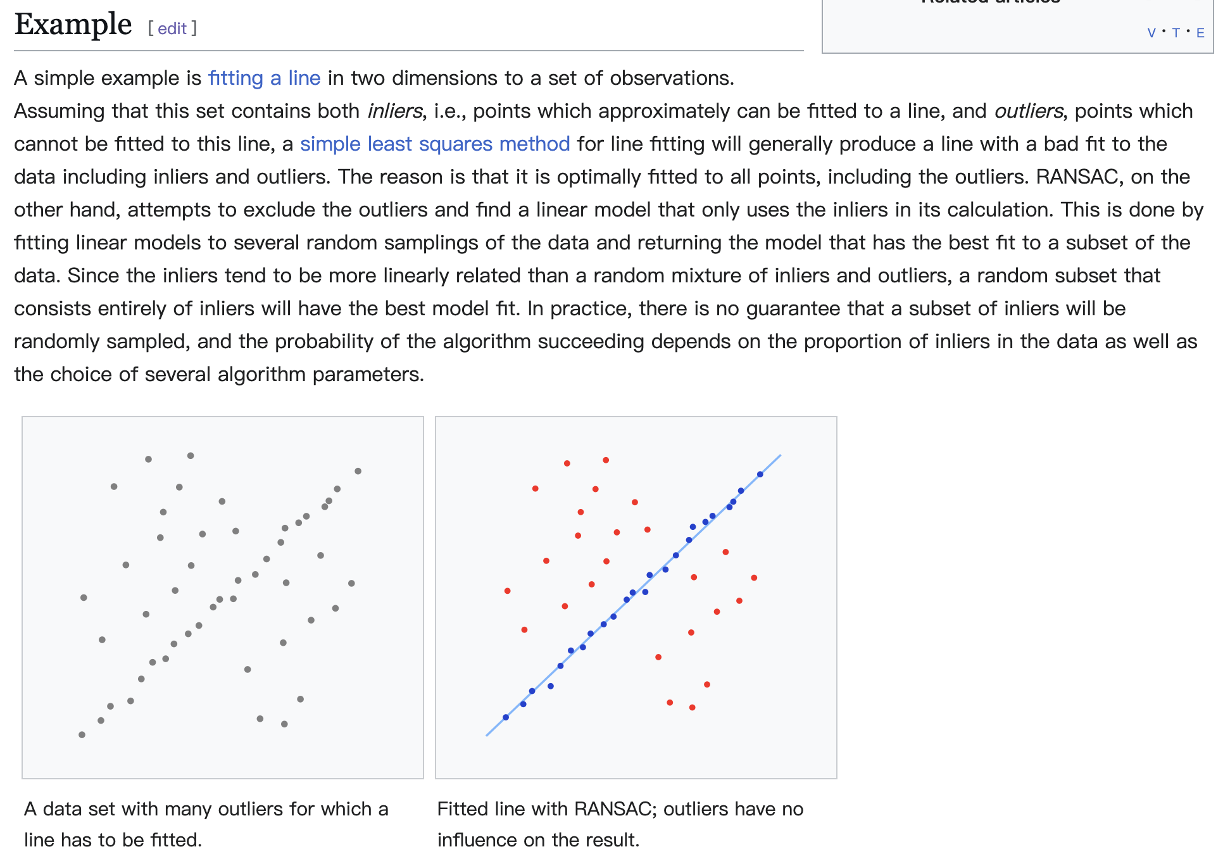
How it works - RANSAC Algorithm
Here is how wikipedia explain it.

Slide 4
Reference
https://www.zhihu.com/question/62127796 - [Articles]
https://en.wikipedia.org/wiki/Random_sample_consensus - [Wiki]

